Slide 1
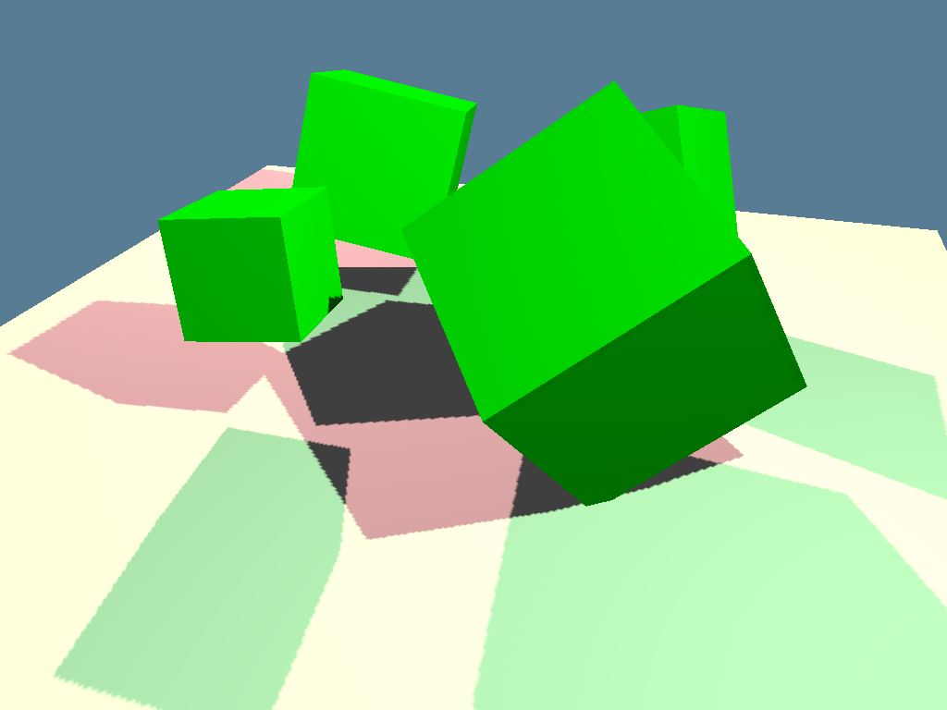
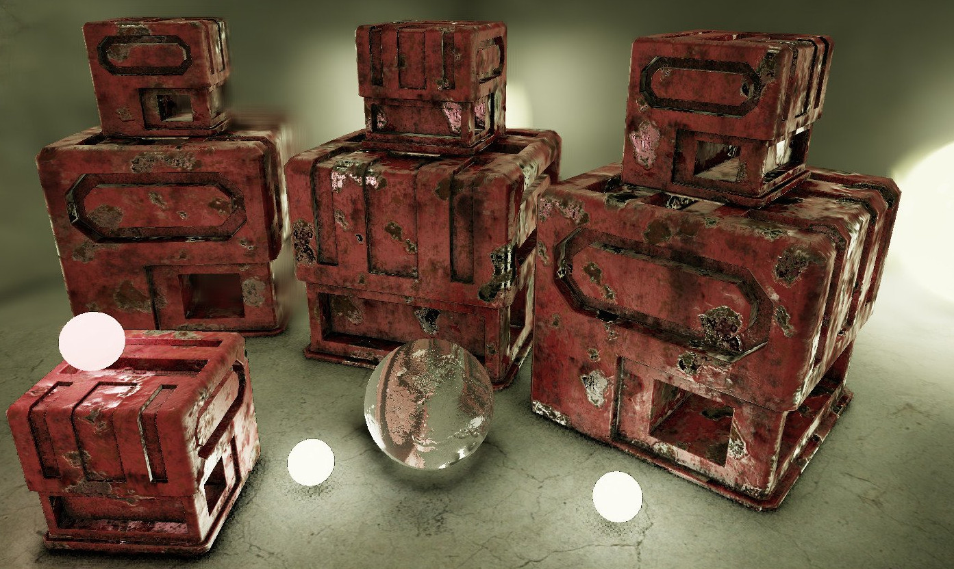
3D Rendering tricks
How do they work?

Slide 2
Agenda
Context
Vertices
How do(es) […] work?
Perspective Projection
Depth Testing
Anti-Aliasing
Shading
Shadow Mapping
The Graphics Pipeline

Slide 3
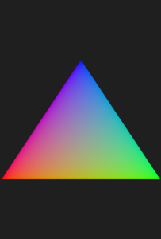
What even is a Vertex?
It’s what primitives are composed of
They can have 1 (dot), 2 (line) or 3 (triangle) vertices.
They are defined using an x, y and z axis, so in code it would be: [0.5, 0.5, 0.0]

Slide 4


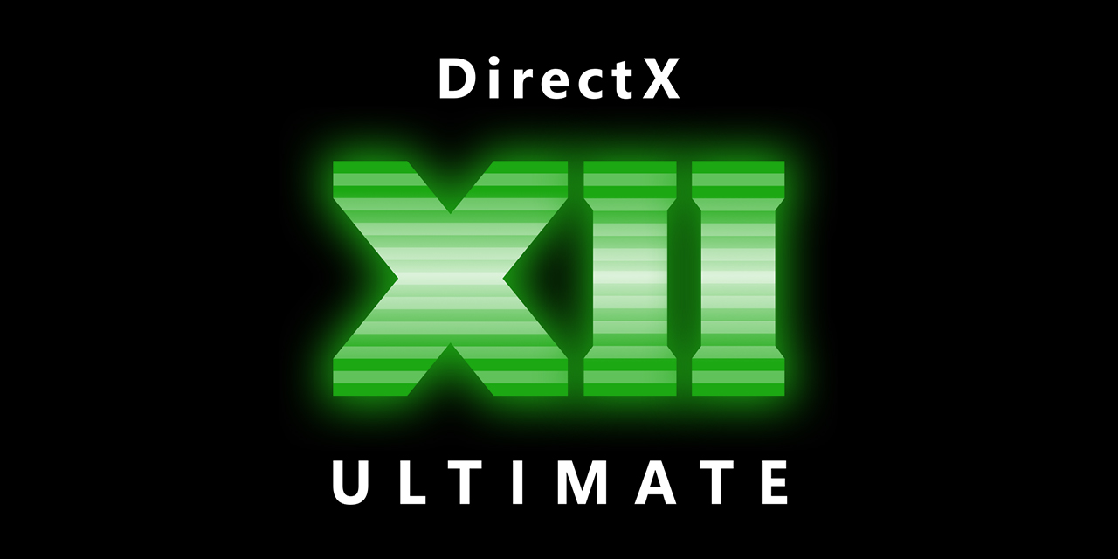
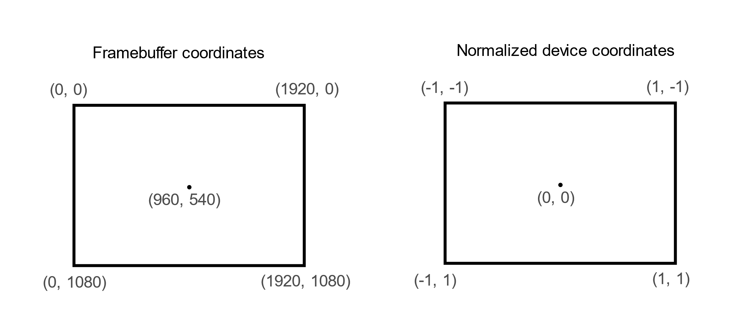
What is the graphics pipeline?
Vertex/index buffer
0
It collects all the raw vertex data into buffers
Input assembler
1
2
0
Runs for every vertex and applies the changes you want to do with them (like transformations)
Vertex shader
1
2
0
Let’s you make changes to the geometry based on certain rules (this helps makes things like brick walls look less flat)
Tessellation
1
2
Run on every primitive and can add or remove primitives than came in.
Like the Tessellation shader but with far more flexibility
The flexibility reduces performance though
0
3
Geometry shader
1
2
It discretizes all the primitives into fragments.
Rasterization
Called for every fragment and it applies colour to those fragments.
Fragment shader
It blends the colours of the fragments together to make the pixels
Color blending
Framebuffer
Notes:
-This pipeline is based on the vulkan implementation of it but they should all be similar
-geometry shader is not used because of the performance impacts
-at the moment, rasterizer only makes 1 fragment per pixel

Slide 5
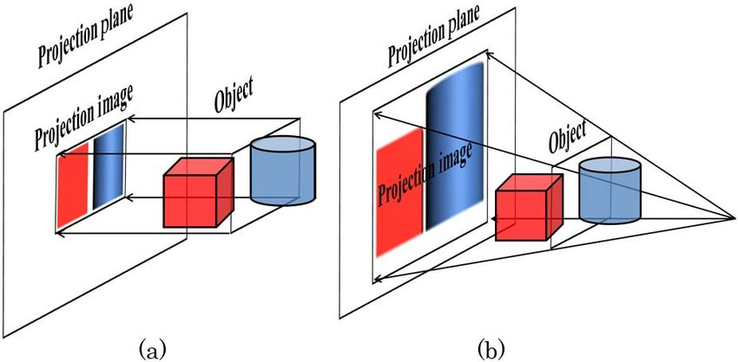


How to make something look 3d?
Math:
$$\sin_{fov}=\sin\left(\frac{fov}{2}\right)$$
$$\cos_{fov}=cos⁡(\frac{fov}{2})$$
$$h=\frac{\sin_{fov}}{\cos_{fov}}$$
$$w=\frac{h}{aspect_ratio}$$
$$r=\frac{z_far}{z_near−z_far}$$
Input:
fov
aspect_ratio
z_near
z_far
Vertex Shader Code:
void main() {
mat4 worldview = uniforms.view * uniforms.world;
gl_Position = uniforms.proj * worldview * vec4(position, 1.0);
}
Matrix:
$\left[\begin{matrix}w & 0 & 0 & 0 \\ 0 & h & 0 & 0 \\ 0 & 0 & r & −1.0 \\ 0 & 0 & r∗z_near & 0\end{matrix}\right]$
Notes:
- The math is too complicated to understand in a 15 minutes presentation, but that’s okay since there’s a load of libraries for this exact thing

Slide 6
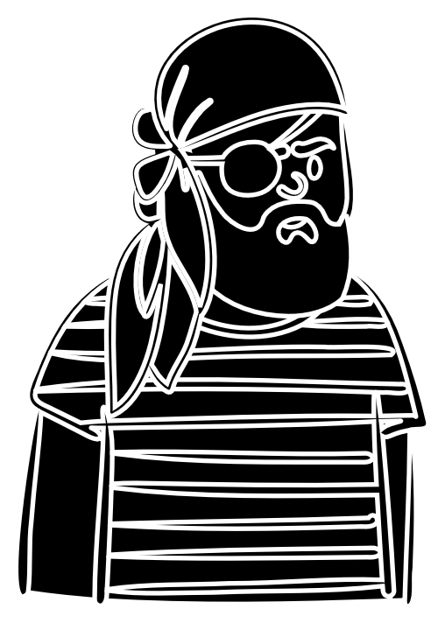
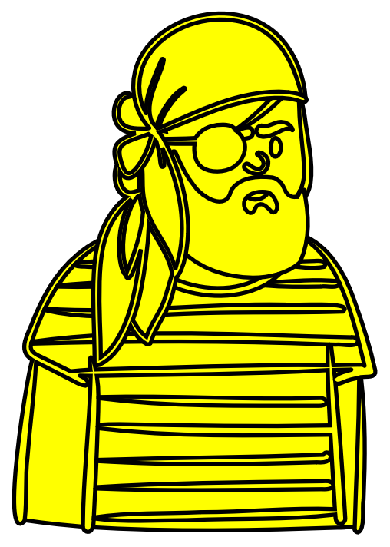

How does Depth Testing Work?
Problem?
Z = 10.0
Z = -10.0
Z = -1.0
Notes:
Black pirate is supposed to be in the back, but ended up in the front

Slide 7
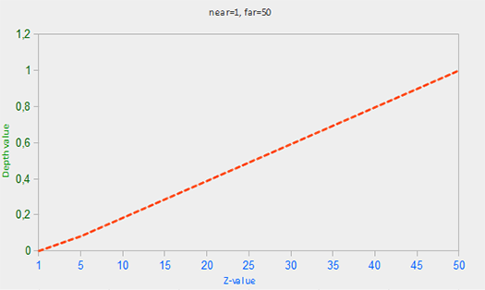
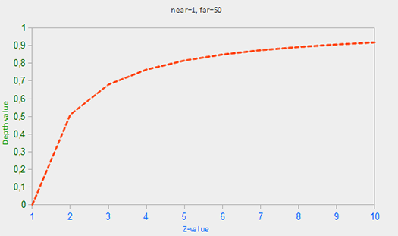

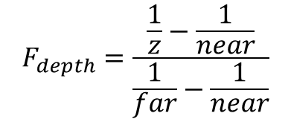
How does Depth Testing Work?
$$F_{depth}=\frac{z−near}{far−near}$$
Solution?
$$F_{depth}=\frac{\frac{1}{z}−\frac{1}{near}}{\frac{1}{far}−\frac{1}{near}}$$
Depth Value Precision!
Notes:
First algorithm works, but it is not ideal because whatever going after 50 would end up getting mushed into under 1 and mess things up
2nd one fixes that
Demonstrate this in the demo

Slide 8
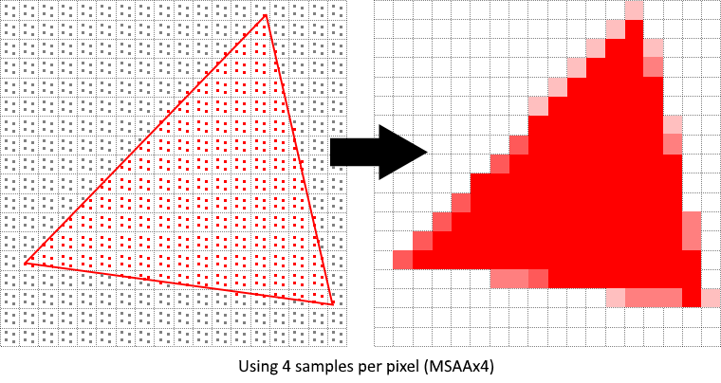
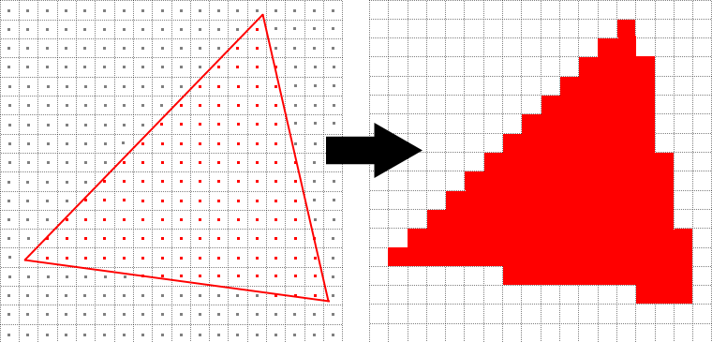
How does Anti-Aliasing work?
Types
Supersample Anti-Aliasing (SSAA)
Multi-Sampling Anti-Aliasing (MSAA)
Fast Approximate Anti-Aliasing (FXAA)
Temporal Anti-Aliasing (TXAA)
Renders a scene at a higher resolution, then lowers it.
Biggest performance impact
Similar to SSAA, but for edges only
Big performance impact
Not like the other AA methods
Runs after image has been rendered
Blurs when there are sharp changes to colours
Mixes AA solutions together to create the best result out of all the solutions here.
What is Aliasing?
Coverage Sampling Anti-Aliasing (CSAA)
It is when smooth curves get a ‘staircase effect’
Nvidia’s version of MSAA that has a smaller performance cost
Enhanced Quality Anti-Aliasing (EQAA)
AMD’s response to CSAA
Notes:
-Primarily focusing on MSAA
-FXAA is the only truly different one out of this list
- There is also a bunch of other versions

Slide 9

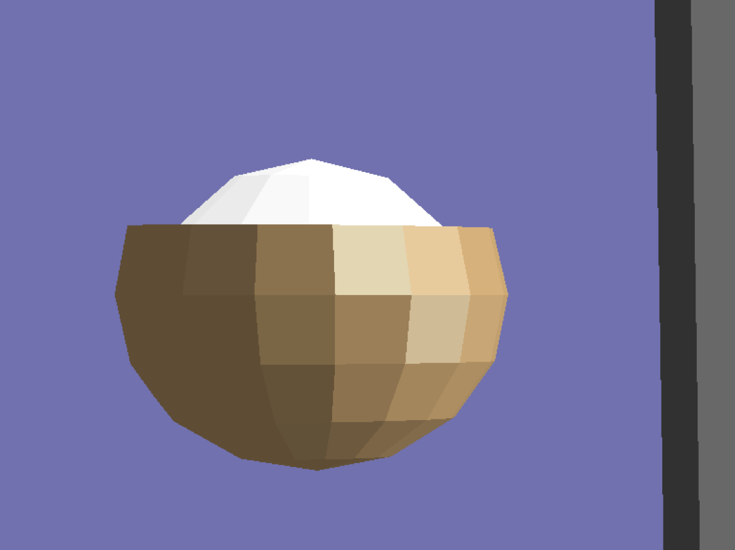
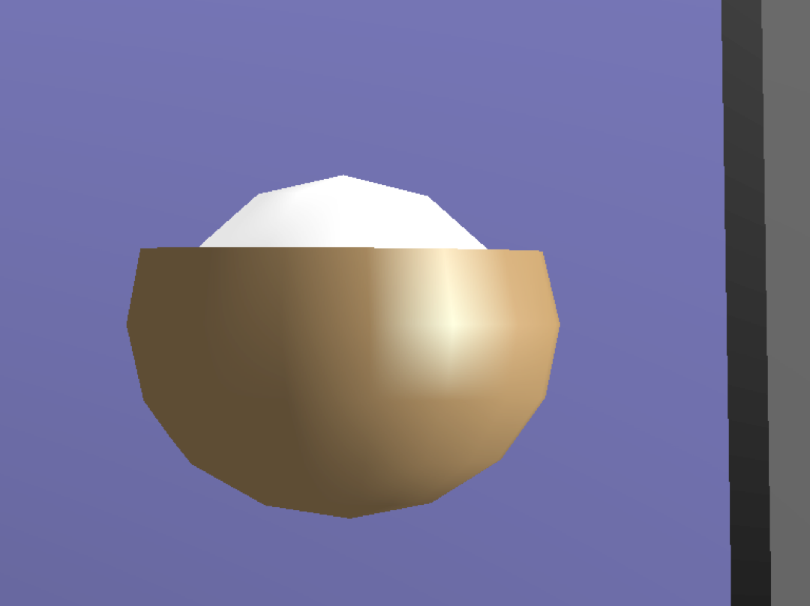
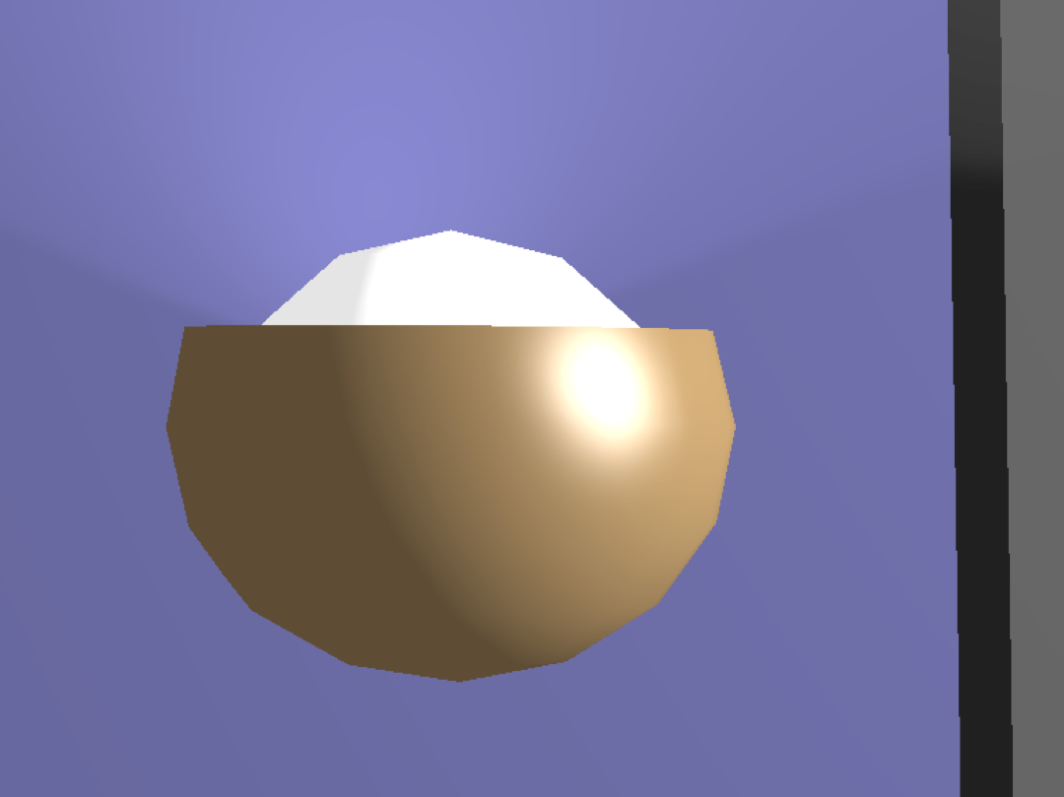
How does shading work?
Types
Flat Shading
Gouraud Shading
Phong Shading
It calculates the normal of a per face basis then applies the dot product with the location of the light.
Same thing as Flat Shading but calculates the normal on a per-vertex basis.
Calculates the normal every time by interpolating them between the normal of the vertices.
What is shading?
It gives objects in view some ‘personality’ using light sources

Slide 10
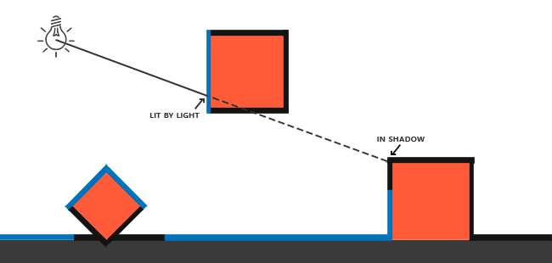
How does Shadow Mapping work?
Render from the POV of the light source
Depth Testing
Perspective projection

Slide 11
Sources
Khronos group, Introduction, Graphics pipeline basics
NVIDIA, Vertex Shaders
Jonathan David Pfautz, Depth Perception in Computer Graphics, May 2000
Zach Cabading, Anti-Aliasing: Everything You Need to Know, August 28 2019
Joey de Vries, Shadow Mapping | Depth Testing, 2014
Zwicker Matthias, Phong Shading, Marc Stamminger, in Point-Based Graphics, 2007
https://github.com/bitshifter/glam-rs/blob/main/src/f64/dmat4.rs

Slide 12

Demo Time!

